Slide 1
Overview of NCFDD Institutional Membership
www.FacultyDiversity.org

Slide 2
About the NCFDD
Today’s Facilitator
The National Center for Faculty Development & Diversity (NCFDD) is an independent professional development, training, and mentoring community of faculty, postdocs, & graduate students from over 500 colleges and universities.
NCFDD is 100% dedicated to helping academics thrive in the Academy.
www.FacultyDiversity.org

Slide 3
Resources: The Monday Motivator
Our most popular membership resource!
The Monday Motivator is a weekly email that provides tips and strategies to increase productivity and work-life balance by reinforcing the skills and strategies presented in the Core Curriculum.

Slide 4
Resources: Core Curriculum Webinars
Our Core Curriculum webinars teach 10 Key Skills for thriving in academic positions.
Month | Core Curriculum
Jan | Every Semester Needs A Plan
Feb | Align Your Time With Your Priorities
March | Develop A Daily Writing Practice
April | Mastering Academic Time Management
May | Every Summer Needs a Plan
June | Moving From Resistance to Writing
July | The Art of Saying ‘No’
Aug | Cultivating Your Network of Mentors, Sponsors and Collaborators
Sep | Overcoming Academic Perfectionism
Oct | How to Engage in Healthy Conflict
Nov | Strategies for Dealing with Stress and Rejection

Slide 5
Resources: Guest Expert Webinars
NCFDD also hosts Guest Expert Webinars on varied topics such as:
Developing Anti-Oppressive Communities: Supporting Black Students and Mentees
Resting to Rise: Reduce Burn Out, Find Your Joy for Writing and Life, and Create a Just Academia
Moving from Associate to Full Professor
Writing for a Broader Audience: How to Convey Complex Ideas in Clear, Accessible Prose

Slide 6
Resources: Multi-Week Courses
Membership also includes Multi-Week Courses – webinar series’ that run over the course of 3-4 weeks. Example titles include:
From Project to Publication—the Art of Manuscript Revision
Writing Science: How to Write Papers That Get Cited and Proposals That Get Funded
How to Craft and Submit a Winning Book Proposal in Four Weeks
Building a Publishing Pipeline: Concrete Strategies for Increasing Your Writing Productivity
How to Write an NIH Grant

Slide 7
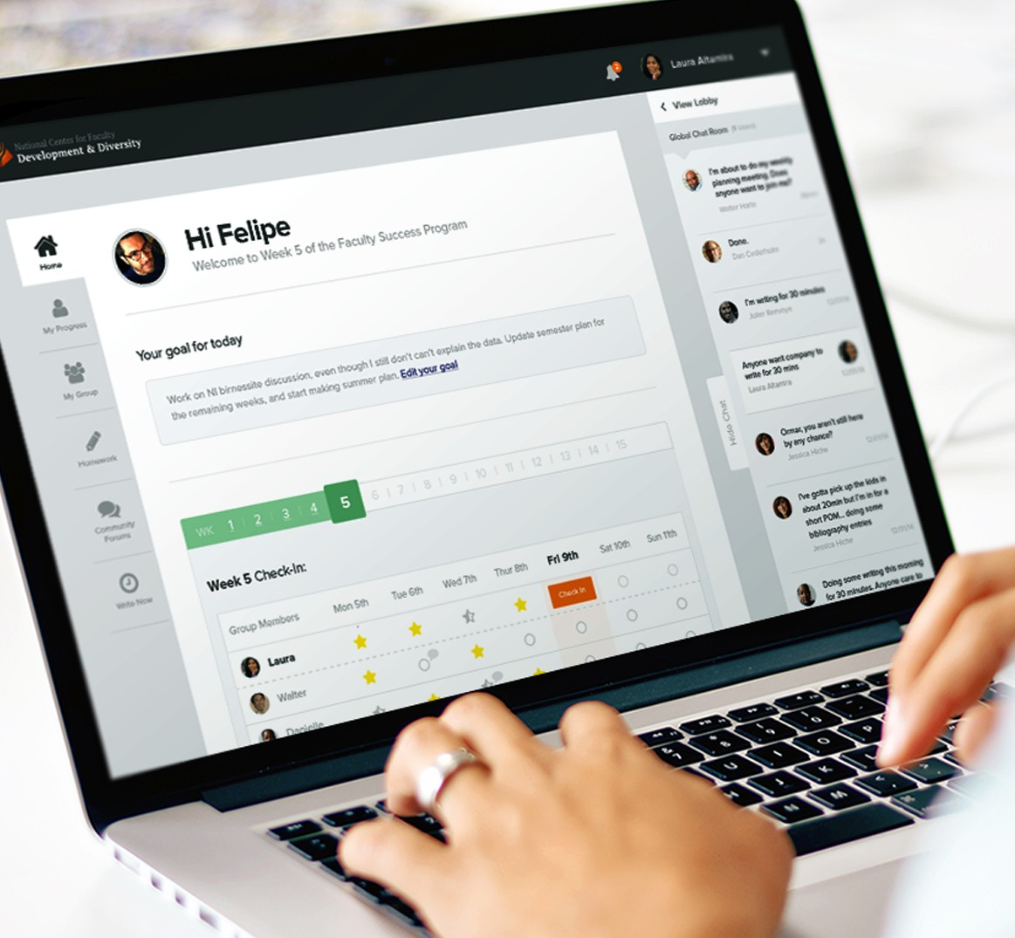
Resources: 14-Day Writing Challenge
Every semester, members are invited to join a 14-Day Writing Challenge.
It’s an opportunity to experiment with daily writing, online community, and supportive accountability on our WriteNow platform.
Participants can also look forward to a daily dose of encouragement in their inbox from the NCFDD Team.

Slide 8
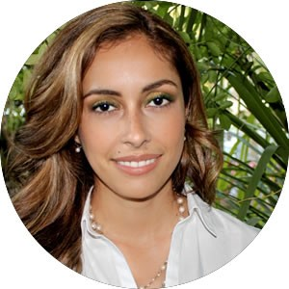
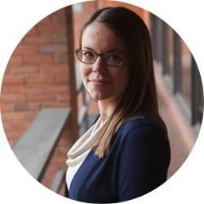
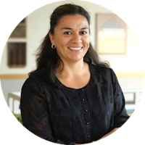
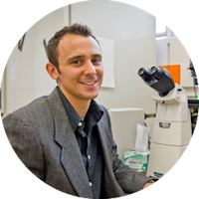
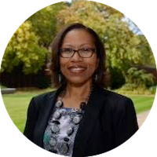
Additional Member Benefits
Access to our Discussion Forums, including monthly writing challenges
Dissertation Success Program for advanced graduate students
Monthly “accountability buddy” matches
Access to our continuously growing Webinar Library including hundreds of hours of professional development training
Priority Registration for the Faculty Success Program for sponsoring offices

Slide 9
Virtual or On-Campus Workshops
NCFDD Campus Workshop topics include:
Tenure & Time Management: How to Manage Your Time So You Can Publish Prolifically and Have a Life beyond the Ivory Tower
Writing, Procrastination, and Resistance: How to Identify Your Writing Blocks and Move through Them
Solo Success: How to Thrive in The Academy When You're the Only
in Your Department
Writing Your Next Chapter: How to Find Your Mojo and Move Forward at Mid-Career
Re-Thinking Mentoring: How to Build Communities of Inclusion, Support, and Accountability

Slide 10
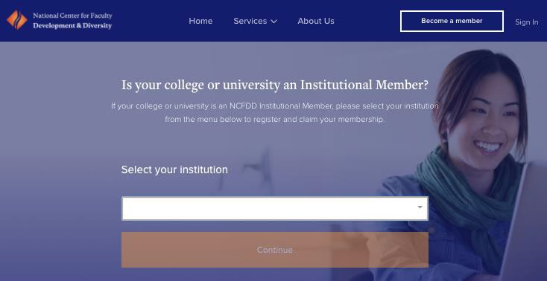
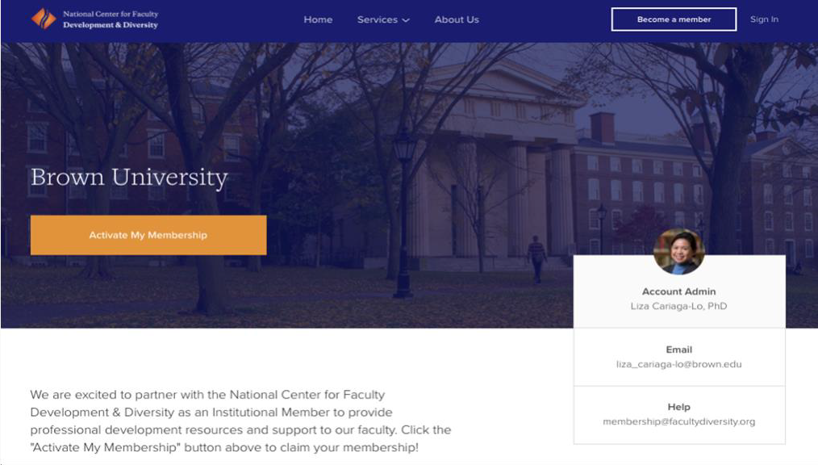
HOW TO CLAIM YOUR INSTITUTIONAL MEMBERSHIP
Step 1: Go to https://www.facultydiversity.org/join. Then select your institution from the drop-down menu and click “Continue.”
Step 2: On the institution’s landing page, click “Activate My Membership.”
Example University
PAH
Photo
Primary Account Holder’s Name
Primary Account Holder’s Email
Step 3: Complete a brief registration form using your institution email address.
Step 4: Open your institution email. Click “Activate Account” in the confirmation email.

